Slide 1

Travel-mate
Travel Recommendation App
Team 06 (2022 2YA)
Dhruv Agarwal
Sarthak Goyal
Pratik Chitlangia

Slide 2

About the Project
Destination Recommendations
Get to know about the locations
Checkout Nearby Hotels
Make a Wishlist
Decide on a Location

Slide 3
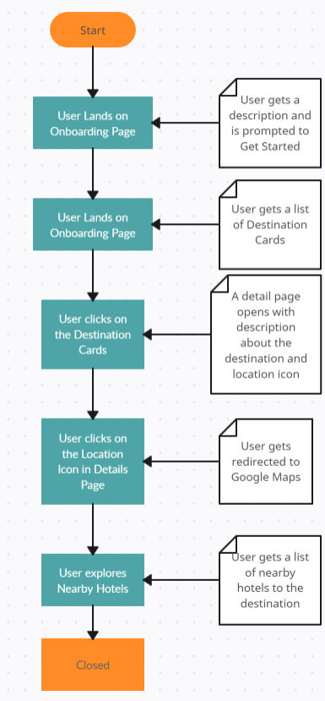
Design/Architecture

Slide 4
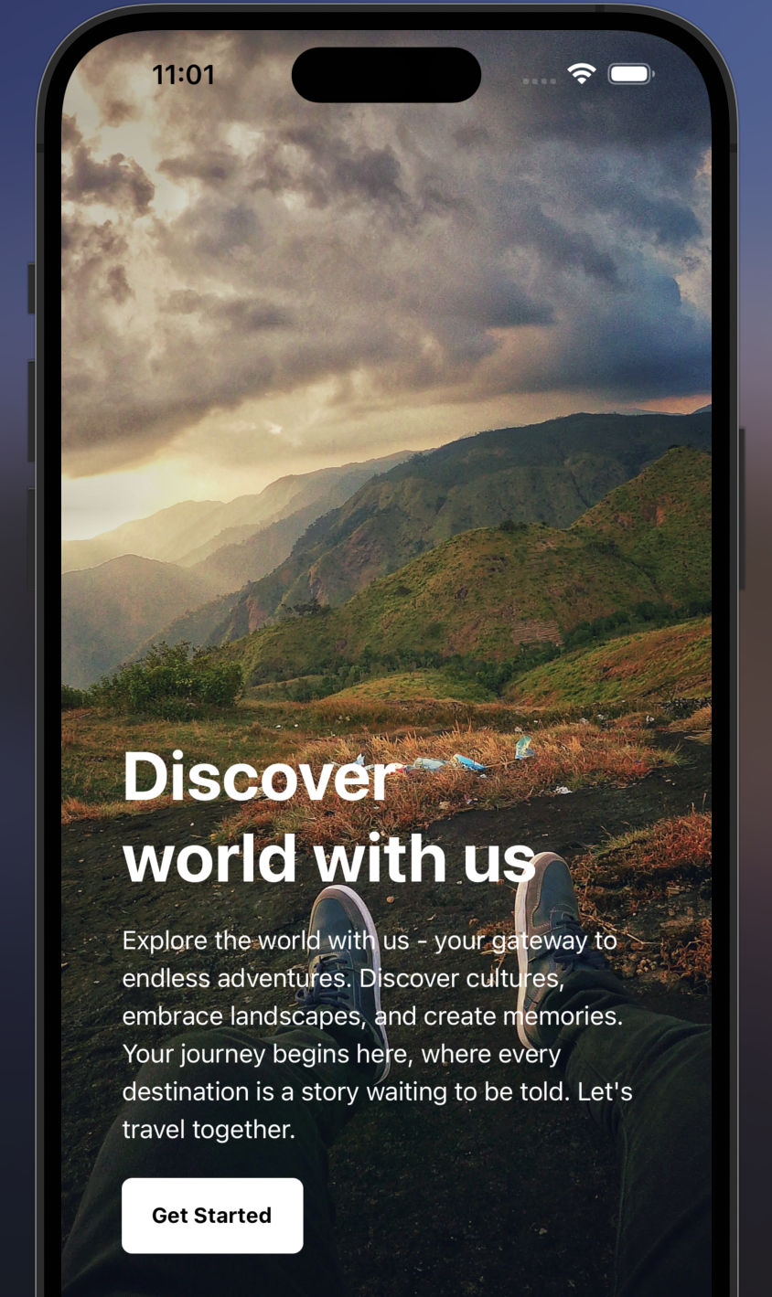
LANDING Page

Slide 5
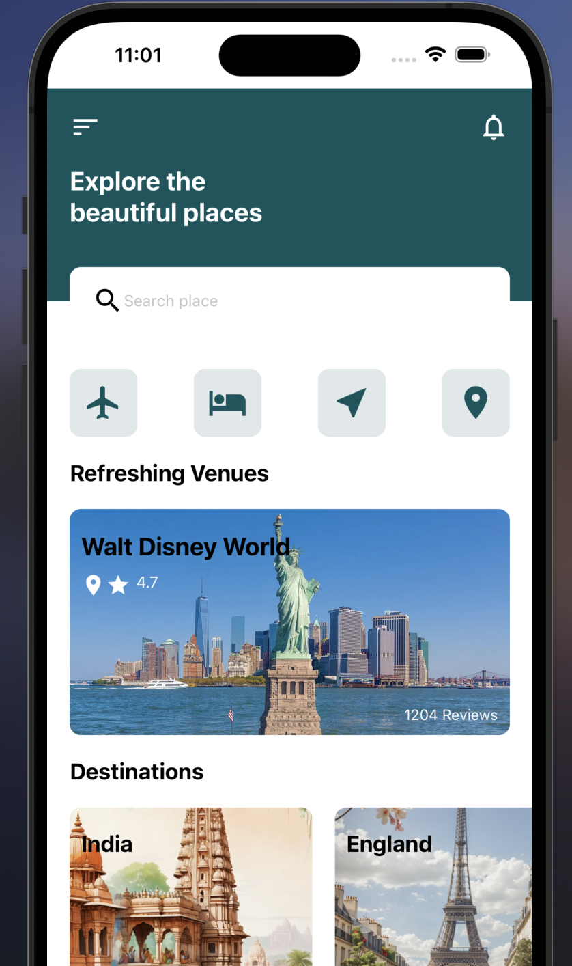
HOME Page

Slide 6
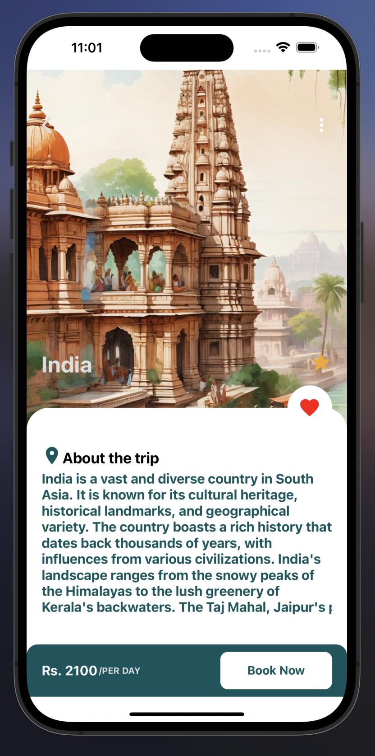
DETAIL PAGE

Slide 7
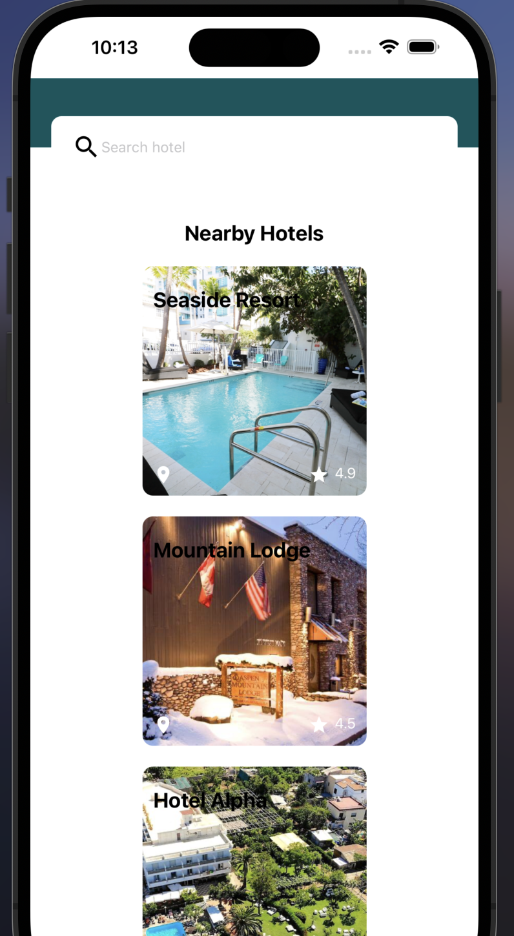
Nearby Hotels

Slide 8
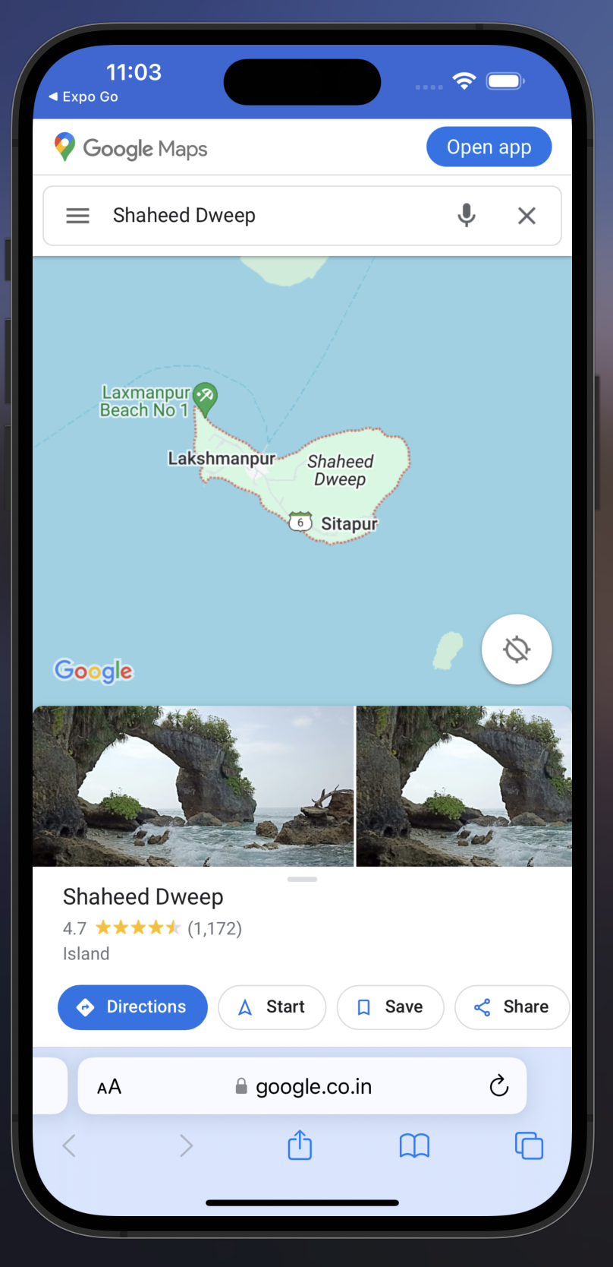
Location on google maps

Slide 9
Challenges & Interesting Points
Cross-Platform Consistency
Ensuring a consistent user experience across different platforms(iOS, Android)
Security Considerations Ensuring proper authentication and encryption practices needs to be implemented.
Running Complexity
Due to the need for separate build process for backend and frontend.
Real-time Data with MongoDB
Due to its NoSQL nature and support for real-time data, can be well-suited for a travel app.
React Native for Mobile
Using react native for mobile part will benefit from a native-like performance and the ability to use native modules when needed.

Slide 10

Thank you

